Slide 1



IAP v IPA
Filling out an ICS 7.1% ABV

Slide 2
Introductions:
Mark van dyke – Spectrum Health
Jan Glarum – A better emergency
Pat mcbride – certified cicerone / com-l

Slide 3
Welcome to founders

Slide 4
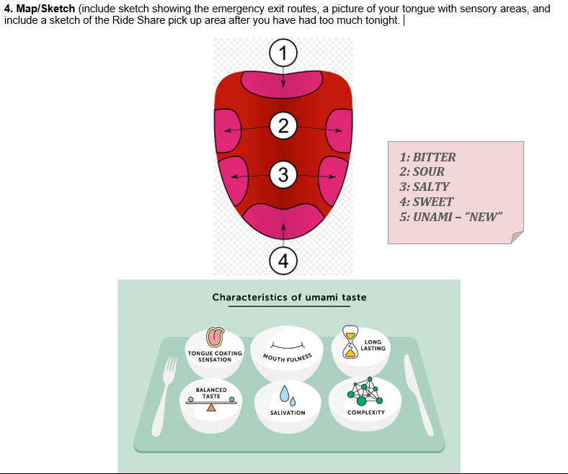

Slide 5
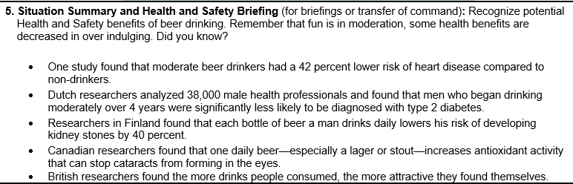

Slide 6
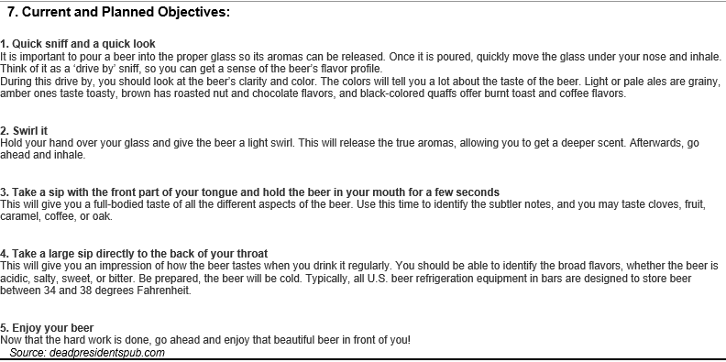

Slide 7
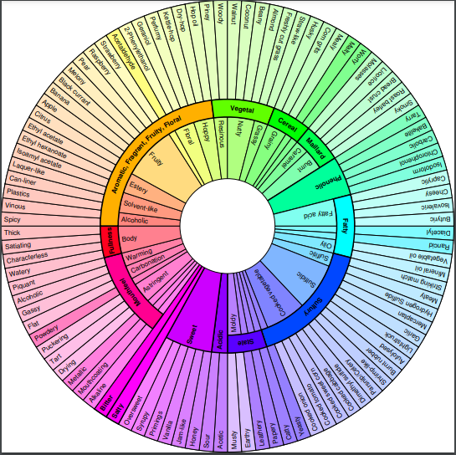
Source: beerflavorwheel.com

Slide 8


1

Slide 9
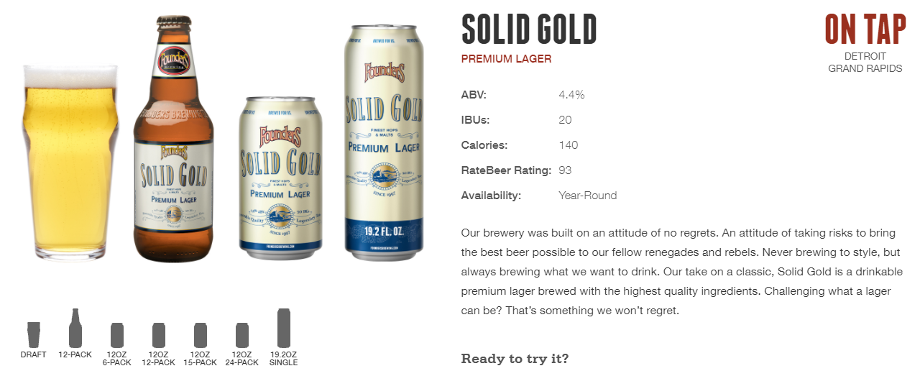

Slide 10
2

Slide 12
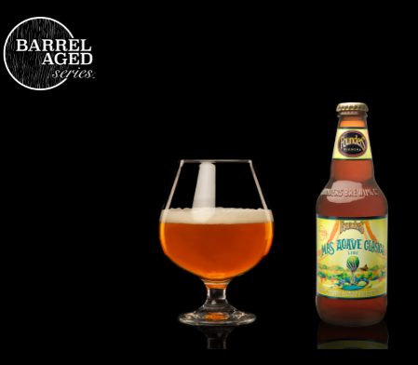

3

Slide 13


Slide 14
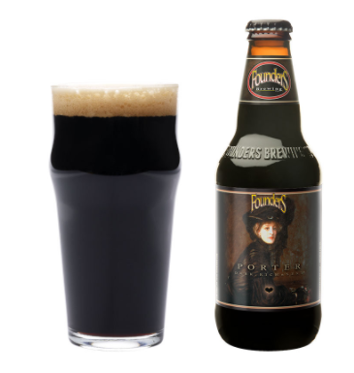

4

Slide 15
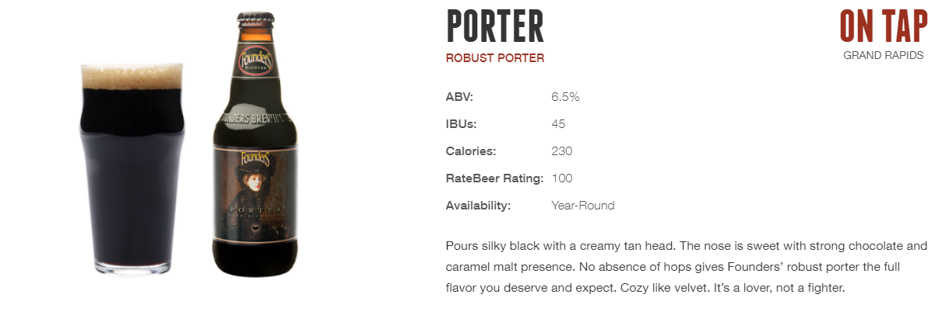

Slide 16


5

Slide 17
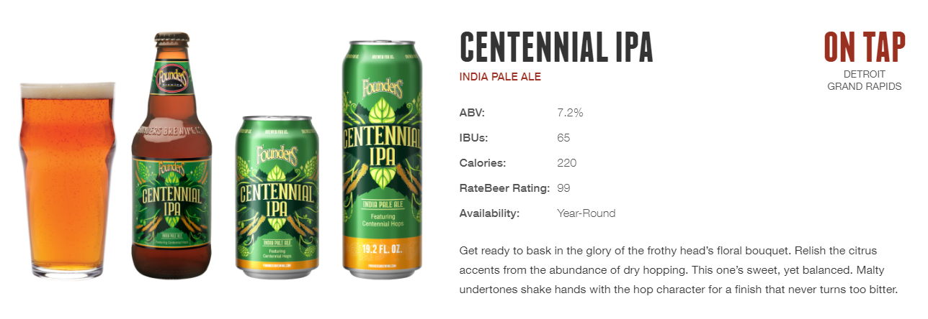

Slide 18
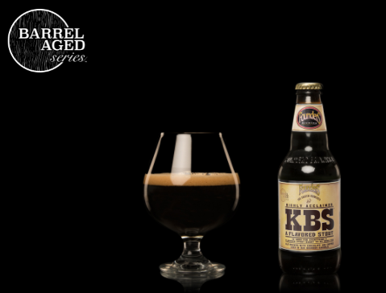

6

Slide 19


